Slide 1
Lab Exercise: 2
Developing agent programs for real world problems

Slide 2
Developing agent programs for real world problems
A toy problem is intended to illustrate or exercise various problem solving methods. It can be given a concise, exact description.
A real world problem is one whose solutions people actually care about. Such problems tend not to have a single agreed-upon description, but we can give the general flavour of their formulations.

Slide 3
Greedy Approach
Greedy Algorithm
Algorithms that follow the idea that the best possible path/answer at all intermediate steps eventually results in the answer of the overall problem.
Closest solution that seems to provide an optimum solution is chosen
This idea does not work for all problems but when it is applicable, it improves the time complexity greatly.
Examples
Kruskal’s algorithm
Prim’s algorithm for finding minimum spanning trees
The algorithm for finding optimum Huffman trees

Slide 4
Graph Colouring Problem using Greedy Approach
Graph colouring is a special case of graph labelling ; it is an assignment of labels traditionally called "colours" to elements of a graph subject to certain constraints.
Vertex coloring is a way of coloring the vertices of a graph such that no two adjacent vertices share the same color.
Edge coloring assigns a color to each edge so that no two adjacent edges share the same color.
Face/Map coloring of a planar graph assigns a color to each face or region so that no two faces that share a boundary have the same color -network routing as well.

Slide 5
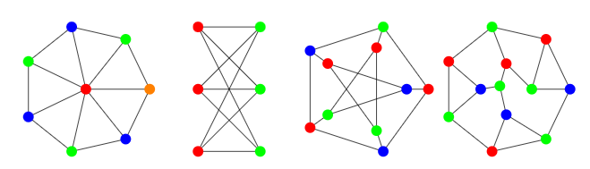
Vertex Coloring
A vertex coloring is an assignment of labels or colours to each vertex of a graph such that no edge connects two identically coloured vertices. The most common type of vertex coloring seeks to minimize the number of colours for a given graph.

Slide 6
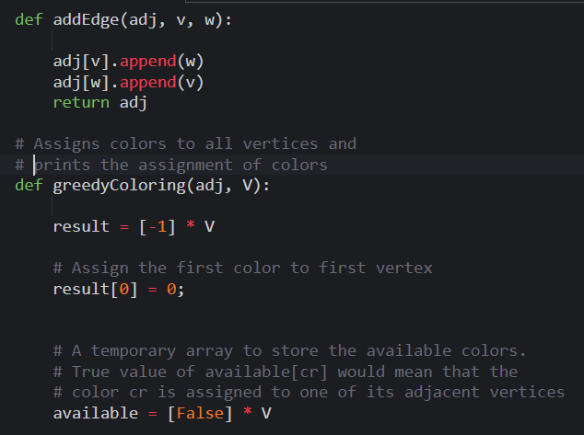
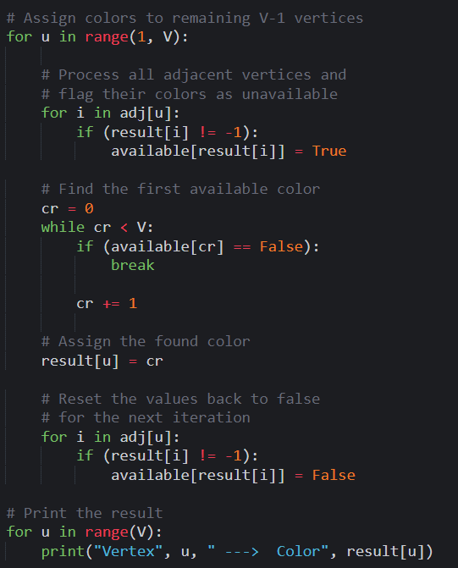
Vertex Colouring

Slide 7
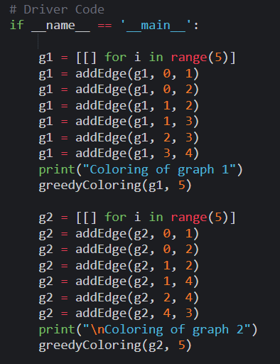
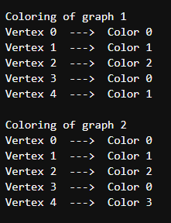
Vertex Colouring
Output:

Slide 8
Thank You
VIVEK BURUGUDDA RA1911003010316
HARSHIL AGARWAL RA1911003010325
RITESH RAI RA1911003010333
PUNEET SHARMA RA1911003010331
PRAKHAR VIJAY RA1911003010337

